Slide 1
How to compare sales from the current year to the previous year with SQL
By Joshua Kab

Slide 2

Description
There is a way to calculate a month-over-month difference. Instead of comparing against the previous month, we can compare against the same month in the previous year.
To make this comparison possible, we need to use the LAG() function’s optional offset parameter, as we can see in the following query

Slide 3
LAG ( ) function
Accesses data from a previous row in the same result set without the use of a self-join starting. LAG provides access to a row at a given physical offset that comes before the current row. Use this analytic function in a SELECT statement to compare values in the current row with values in a previous row
Syntax
LAG (scalar_expression [ , offset ] [ , default ] ) [ IGNORE NULLS | RESPECT NULLS ]
OVER ( [ partition_by_clause ] order_by_clause )

Slide 4
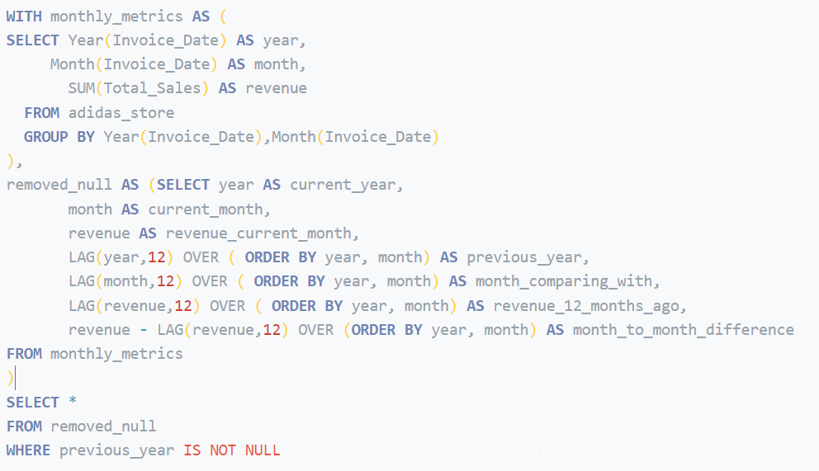
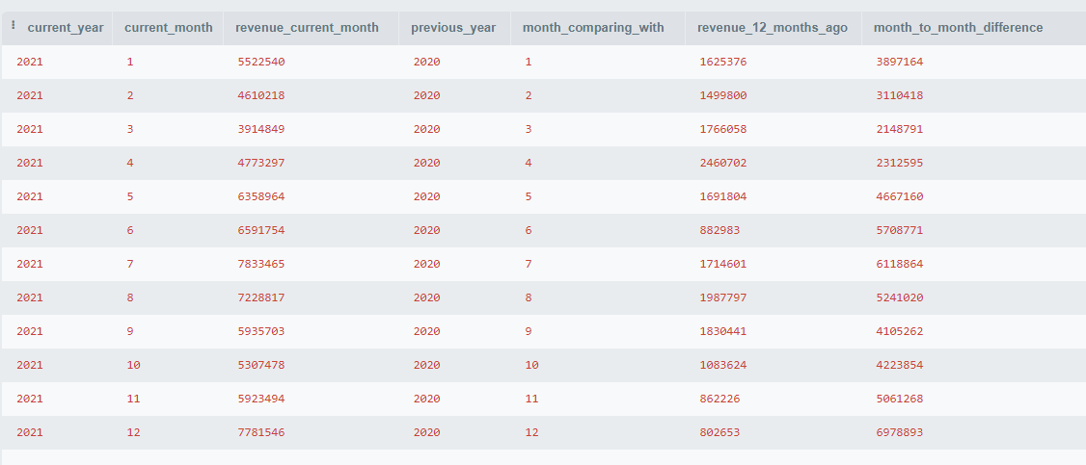
SQL CODE Result

Slide 5
Conclusion
We use the Lag() function to access previous row data as per the defined offset value. It is a window function available from SQL Server 2012 onward. WHERE previous_year IS NOT NULL statement was used to remove the row with null values from the from the previous year column.
We use a Lag() function to access previous rows data as per defined offset value. It is a window function available from SQL Server 2012 onwards. WHERE previous year IS NOT NULL statement was used to removed the row with null values previous year column.

Slide 6

Thanks…

